Slide 1
Connect Four Game
Presented by Hafsah, Gen, Yao, Ilija and Calvin

Slide 2
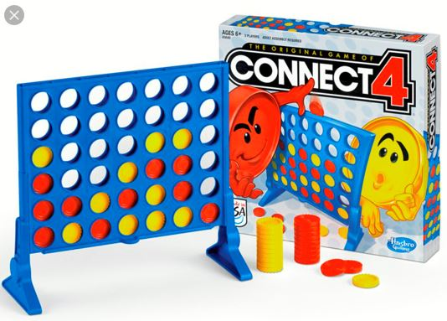
Table of Contents
Our Incentive (Introduction)
Code Design Process
Class Relationships
What We have Learned
Communication
Installation
Gameplay
Conclusion
Call to Action

Slide 3
Our Incentive
We set out to achieve a new goal: creating an actual connect four game.

Slide 4
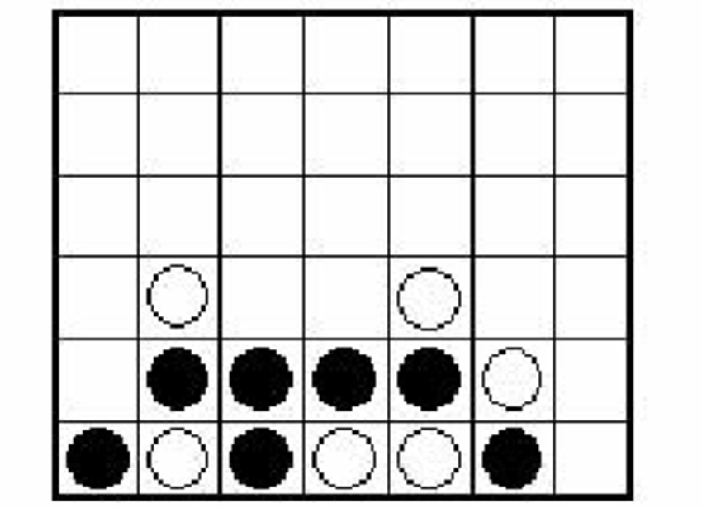
We all know the rules. We played this game as kids, but how do we actually code it out? How do we arrange the visuals and design the code? We pick up on all the little details that matter to deliver this experience.
GUI
Picking column
BACKEND
Inform player:
Who’s Turn: ___
score: ___
score: ___
Who won: ___
No floating
Check direction for win

Slide 5

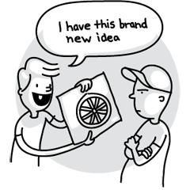
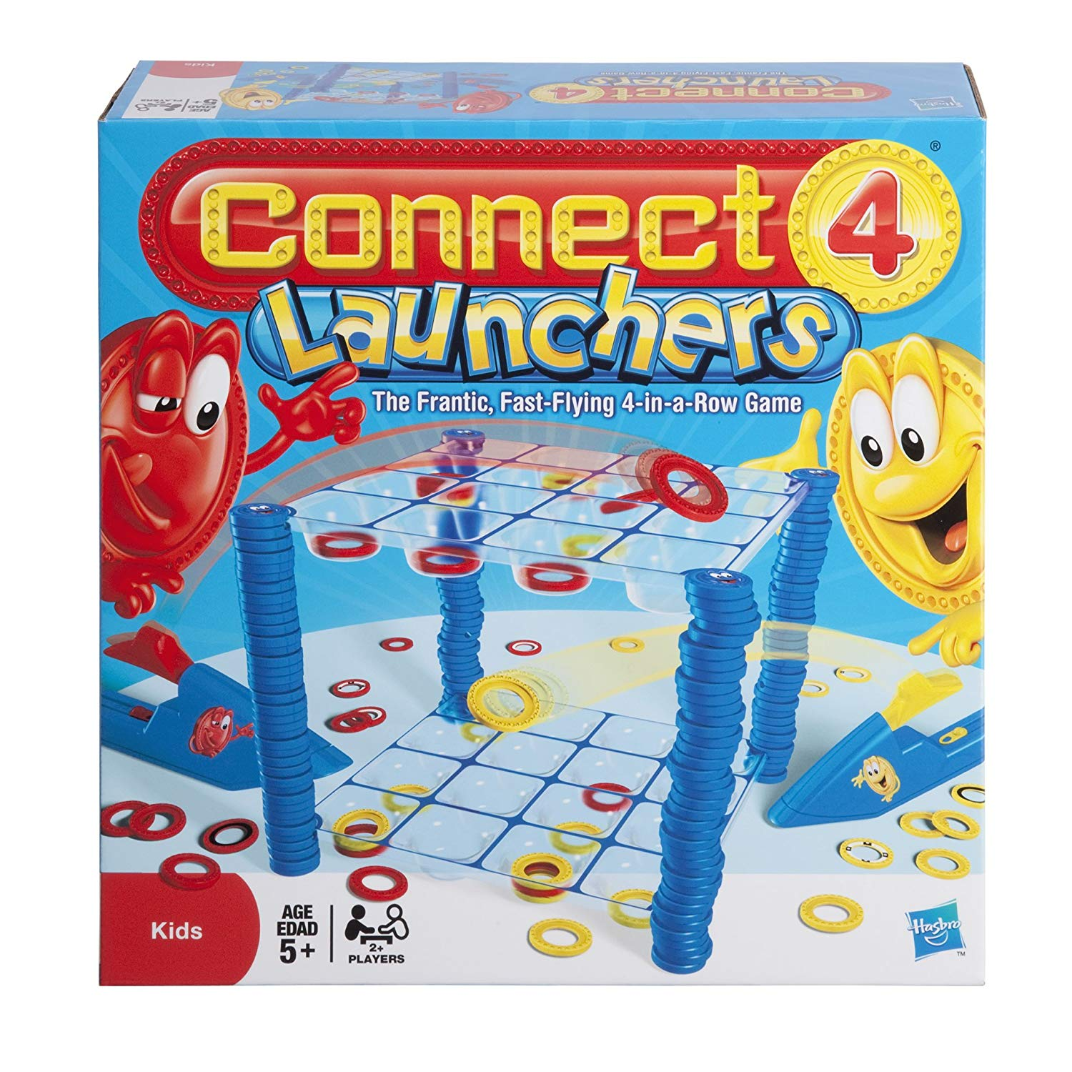
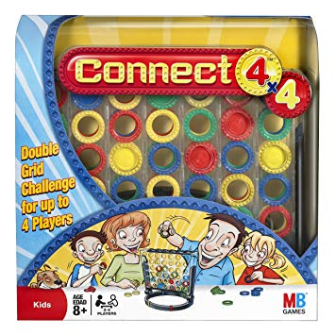
There have been many interpretations of Connect Four. We made our game to be simplest version to keep within scope. So, its not going to be anything new.

Slide 6
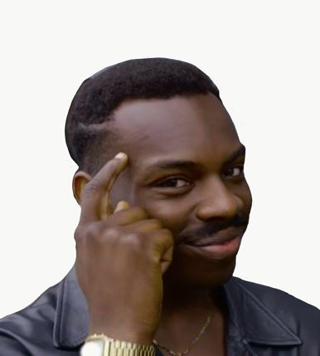


It was a new challenge that we had to overcome, starting with our basic knowledge of python and the game rules.

Slide 7
Code Design Process
Our code design has had a massive overhaul compared to the code design in our previous presentation.

Slide 8
Ex.
<<class>>
ConnectFourBoard
string: P1
string: P2
String: EMPTY
Int: dim_col
Int: dim_row
String: turn
List[List[string]]: board
<<class>>
ConnectFourBoard
string: P1
string: P2
String: EMPTY
Int: dim_col
Int: dim_row
List[List[string]]: board
+ drop(int col): bool
+ other_player(): str
+ whos_turn(): str
+ switch_turn(): None
+ check_for_win(): bool
+ check_win_at_position(row: int, col: int): bool
+ alternation(x: int, y: int, dx: int, dy: int): bool
+ valid_move(col: int, row: int): bool
+ is_game_over(): bool
+ get_drop_loc(col: int): int
+ move_left(): None
+ move_right(): None
+ drop(): None
+ whos_turn(): str
+ check_for_win(): bool
+ valid_move(): bool

Slide 9
We had learned to adapt the “Agile” methodology of coding for our project.
We had been able to progressively adapt slight changes to our class designs and relationships.
This allowed for us to revisit and improve our implementations.

Slide 10
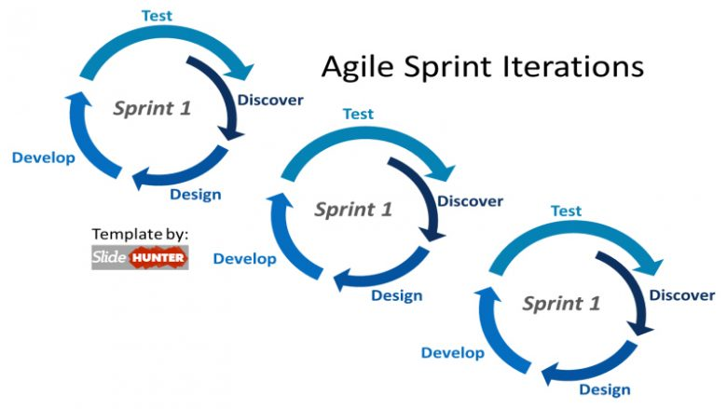

Slide 11
Communication is key
Notes:
14 seconds

Slide 12
Methods of Communication
Whatsapp – General discussion & meeting scheduling.
Github – Code reviewing and commenting on specific lines of code.
Notes:
10 seconds.

Slide 13
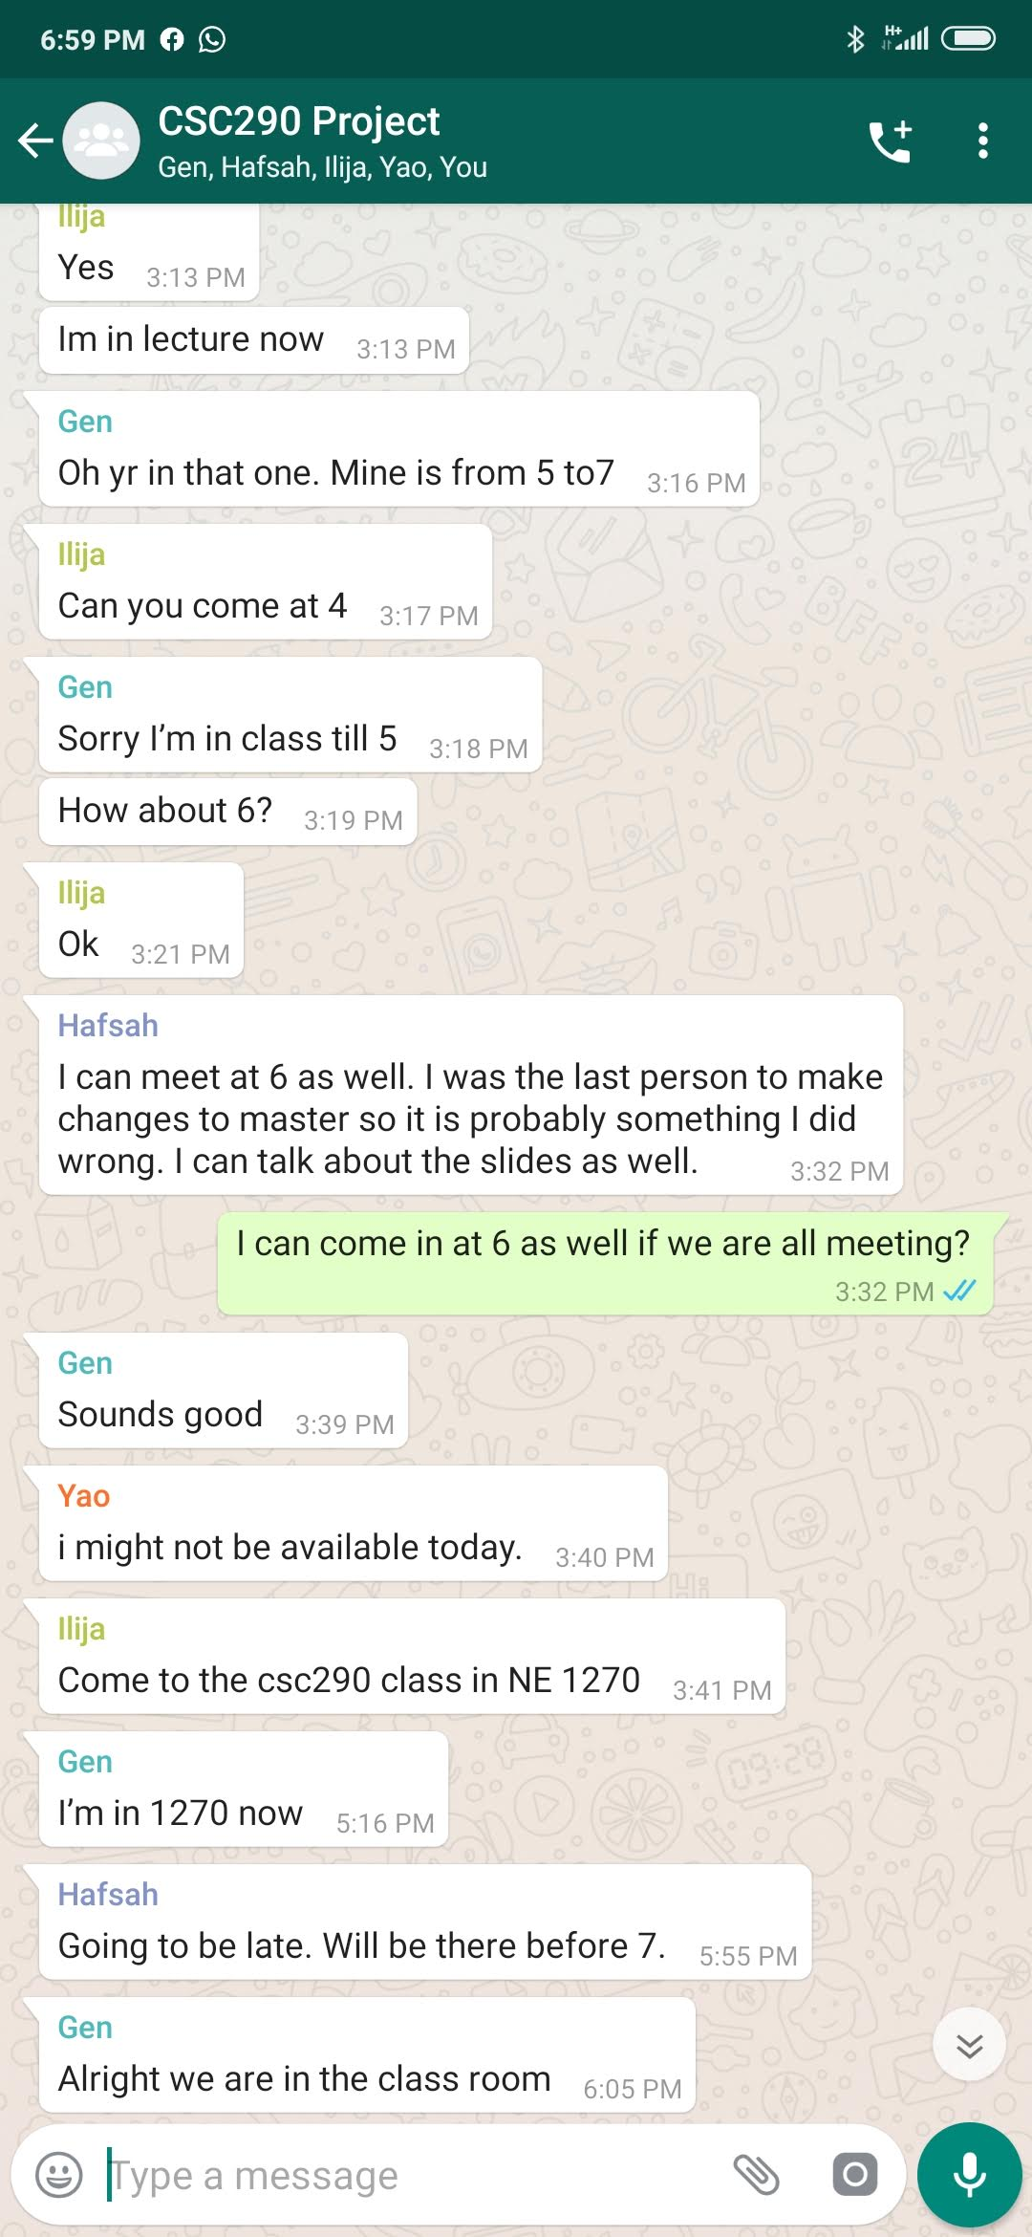
Group Message
Setting up group meetings
Trying to organize tasks and delegate
items for each deadline.
Notes:
13 seconds

Slide 14
Github Pull Requests
Helps with collaboration between developers developing in the same file or working on widely used functions.
Shows the exact changes the developer made and what was changed between the commits.
Allows the reviewer to comment on each section/line of code and request changes from the developer.
Notes:
13 seconds

Slide 15
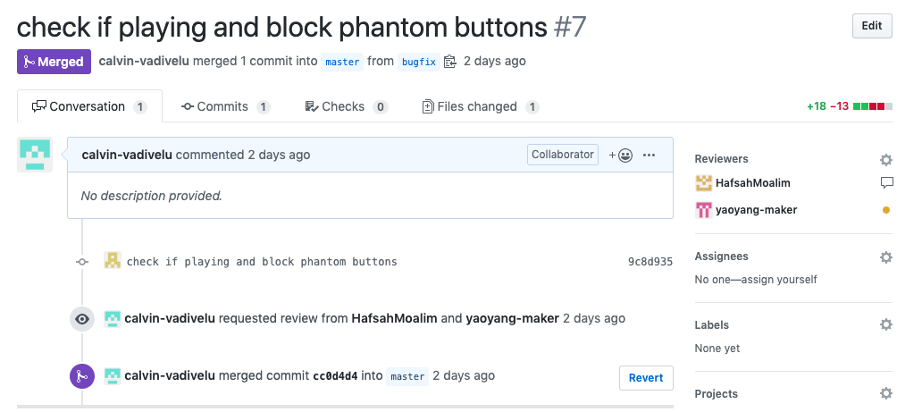
Notes:
11 seconds

Slide 16
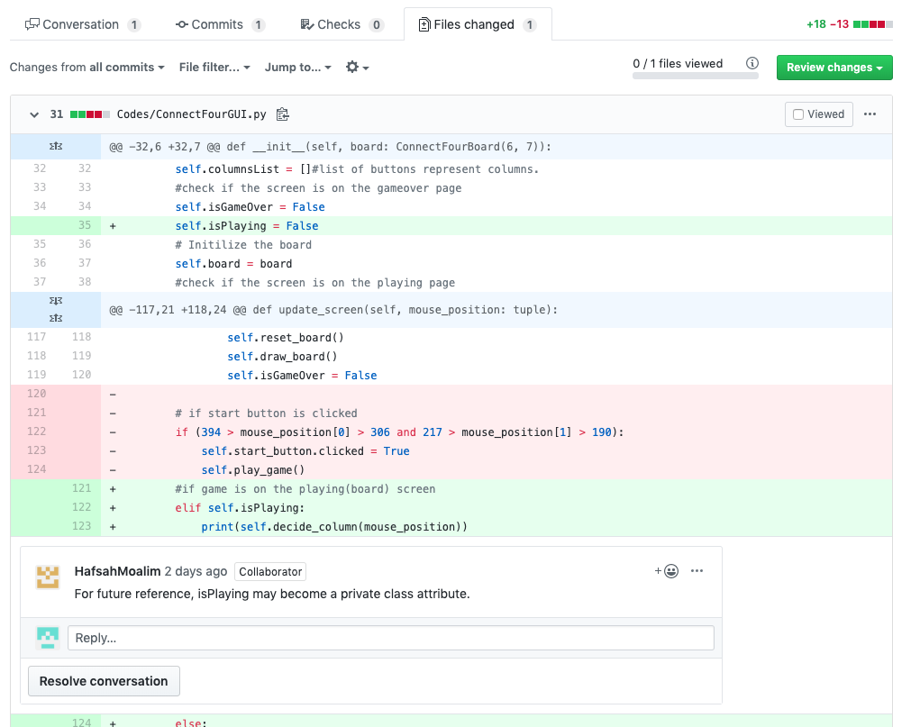
Notes:
11 seconds.

Slide 17
Face to face meetings are king
Everything aside, nothing is as valuable as meeting with your group face to face live to discuss progress.
Even just meeting up to code collaboratively and pushing a few features out is unmatched in terms of efficiency.
Notes:
13 seconds.

Slide 18
Installation

Slide 19
No installation required
MacOS/Linux user:
Download ConnectFour.app
Windows user:
Download ConnectFour.exe
No Python, Pygame etc needed.
Download Link:
https://github.com/NMZ0429/Connect-Four-Project/archive/master.zip

Slide 20
Game Play

Slide 21
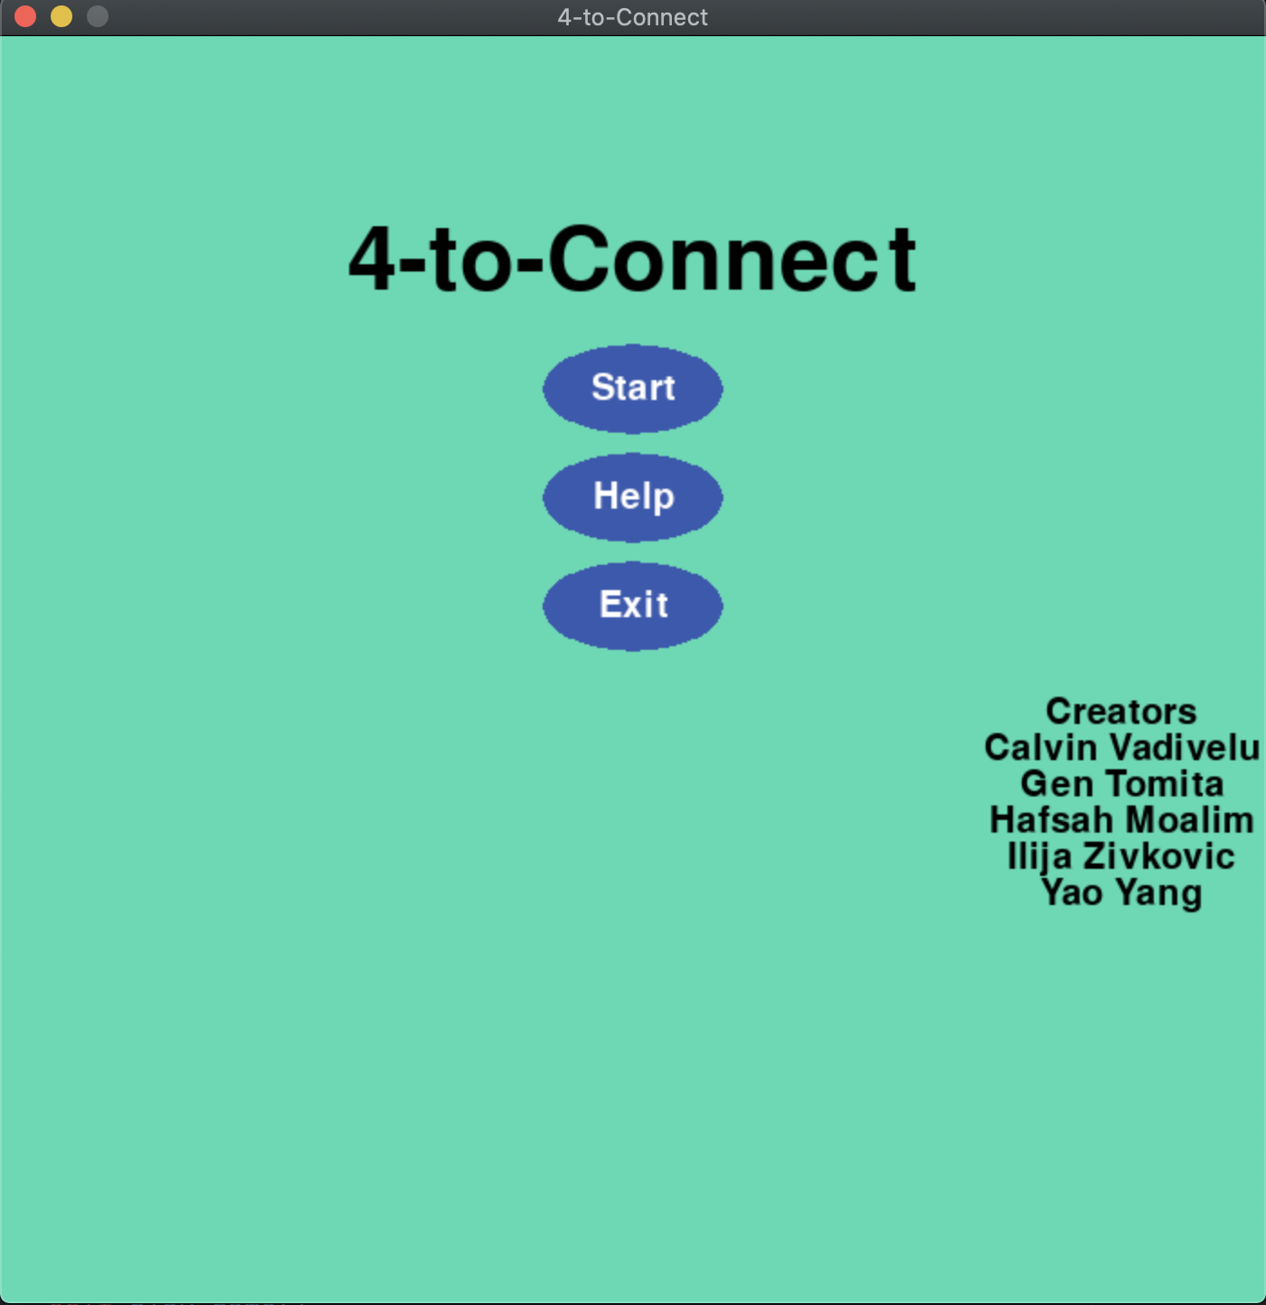
Start Menu
Three options
Play the game
See how to play
Quit the game

Slide 22
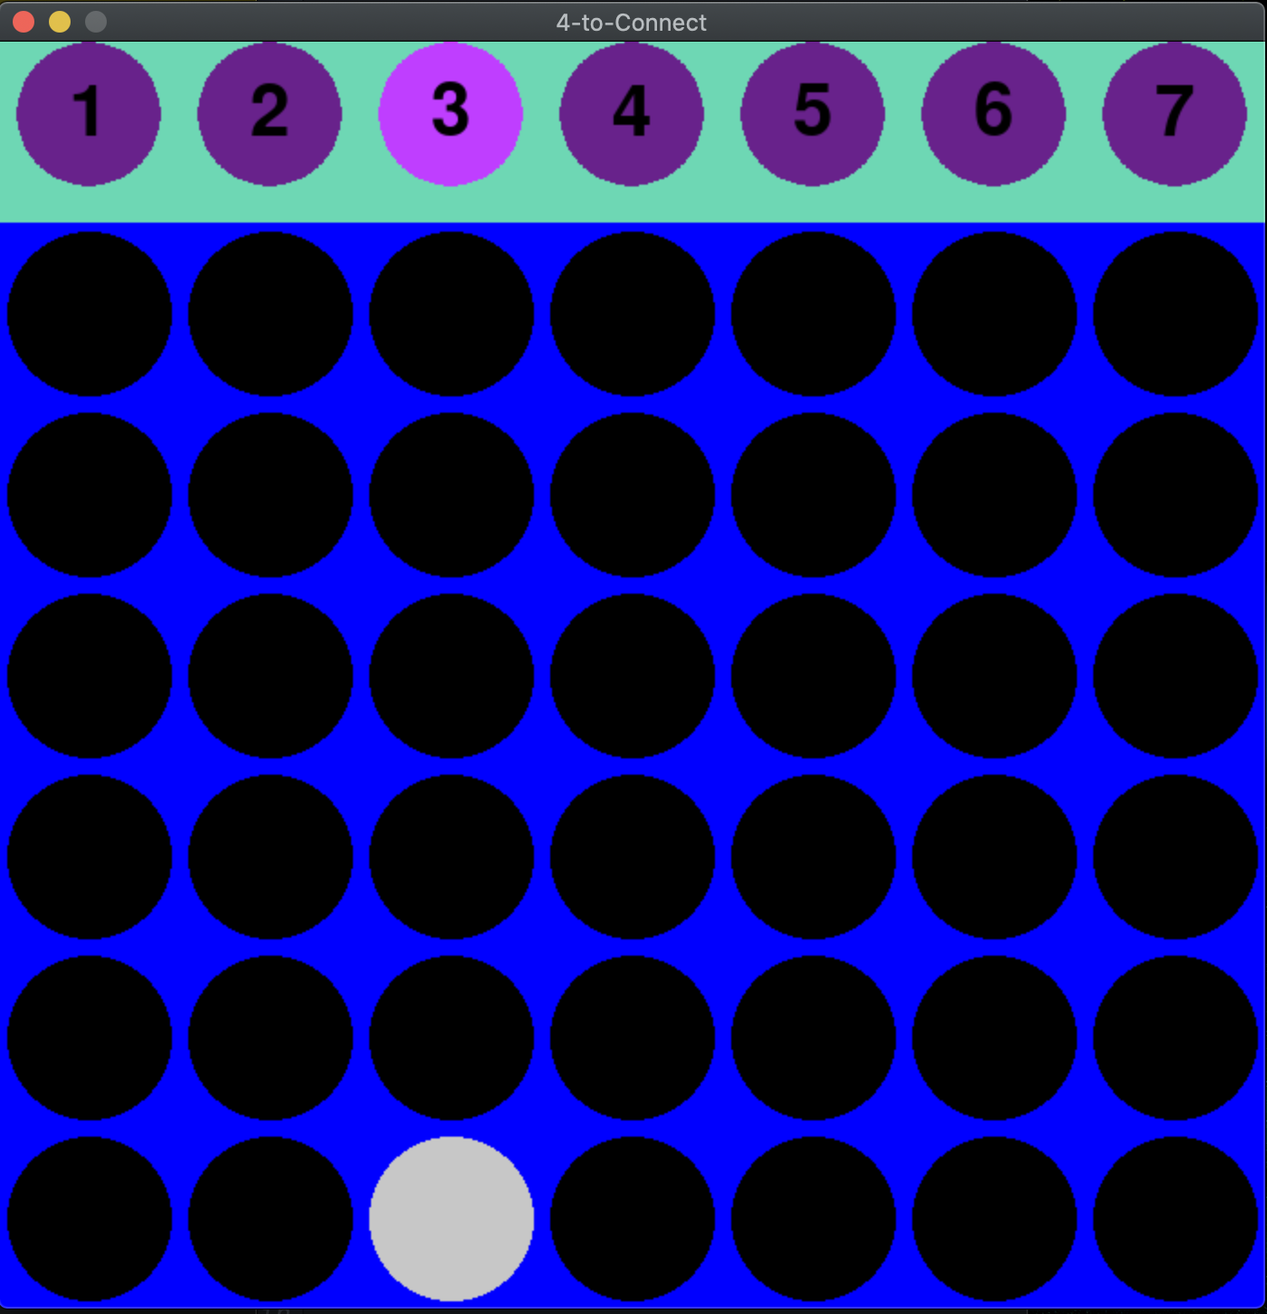
How to play
Click a column to put your stone
GUI highlight which column you are on
Any place within the column is clickable

Slide 23
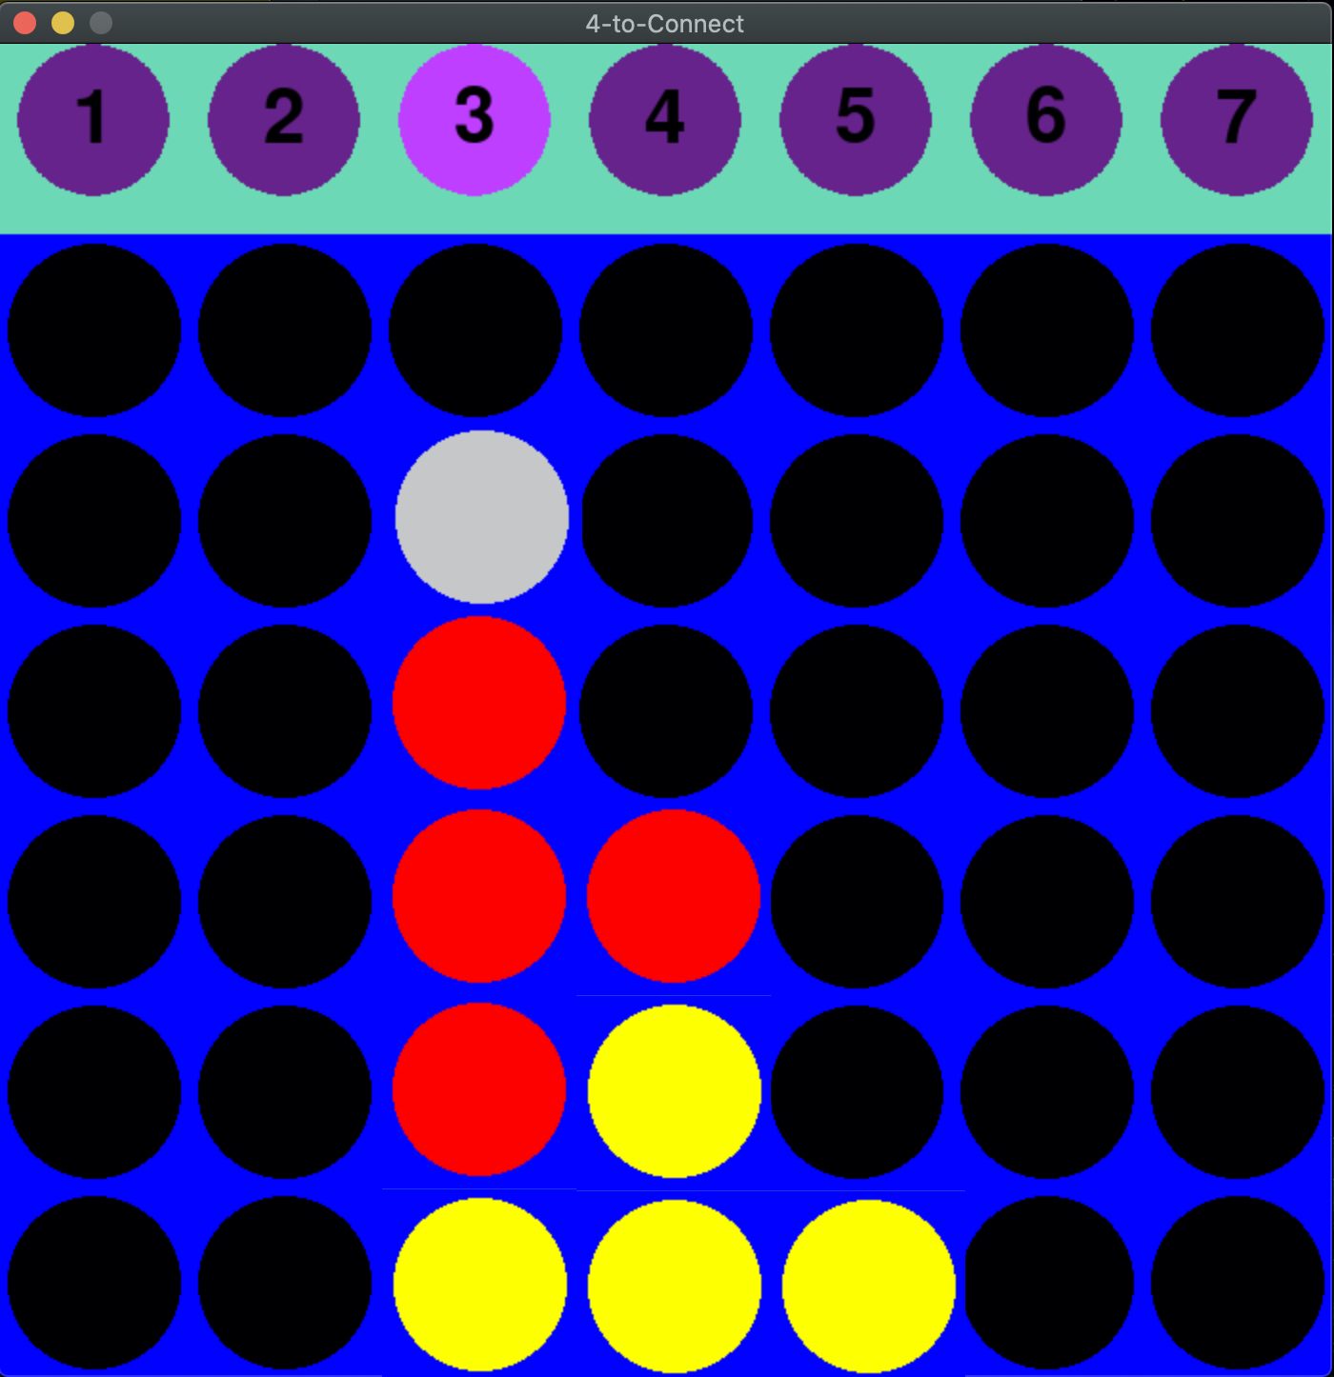
Turn change
Player’s turn is automatically switched after each click
Red stone: Player 1
Yellow stone: Player 2

Slide 24
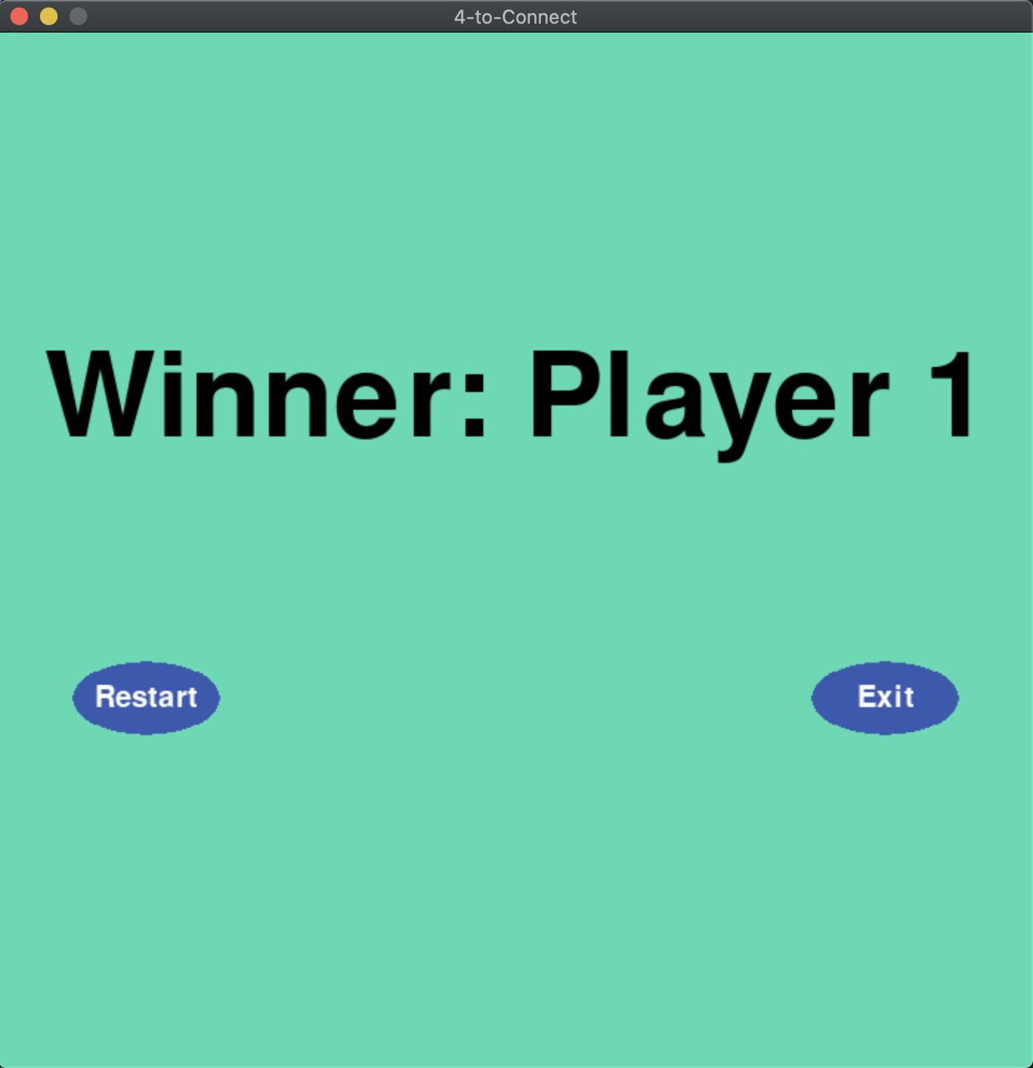
End view
Game will end when 4 stones are on a line
Then the game will show end view
You can play new match or quit

Slide 25
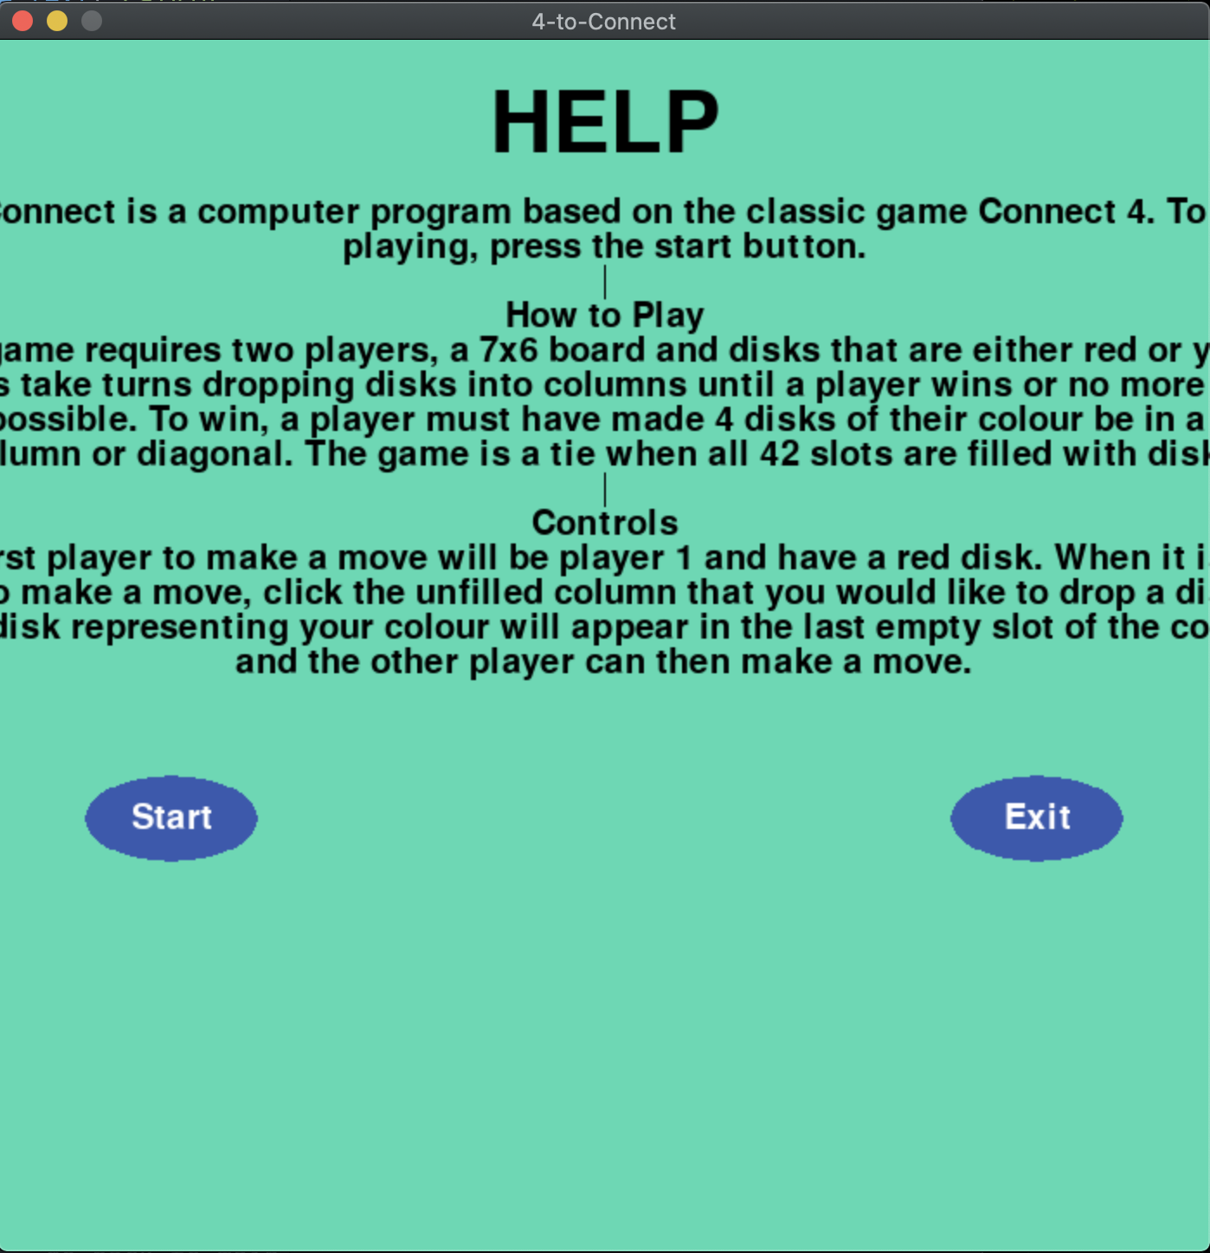
Help page
Click ”Help” in start menu
Rules and how to play

Slide 26
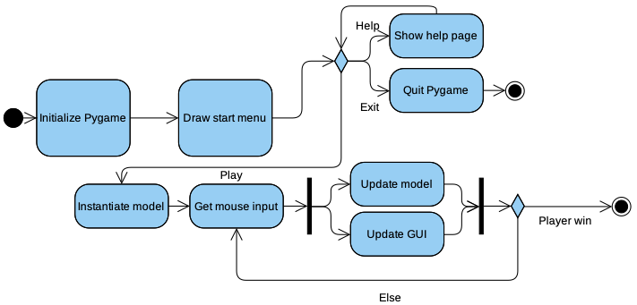
Activity diagram

Slide 27
What we have learned from project?

Slide 28

Meet in person
Scheduling meeting can be hard, but it is necessary.

Slide 29

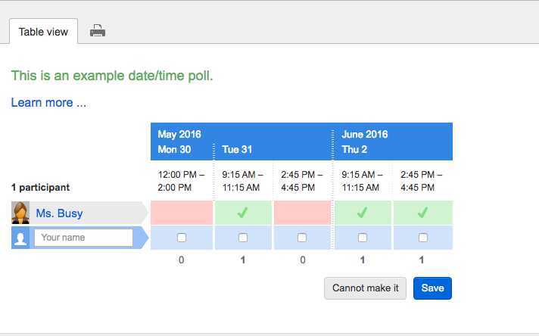
How to do better?
Using tools.

Slide 30

Milestones are important.

Slide 31
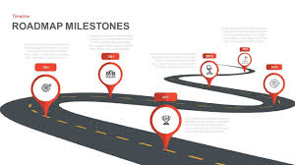
Strictly follow the milestones.

Slide 32
Conclusion

Slide 33
Thank you for listening
We have been having a lot of fun collaborating and learning to try and get this thing to come together.
We would definitely love it for all of you guys to check out our game, we will keep the game’s executables up to date so you guys can keep up with our game through it’s phases and hopefully get to see it finish along with us.
Thank you all and we are looking forward to your feedback/questions!

